Slide 1
WCD FINAL Project
Steven Yuen

Slide 2
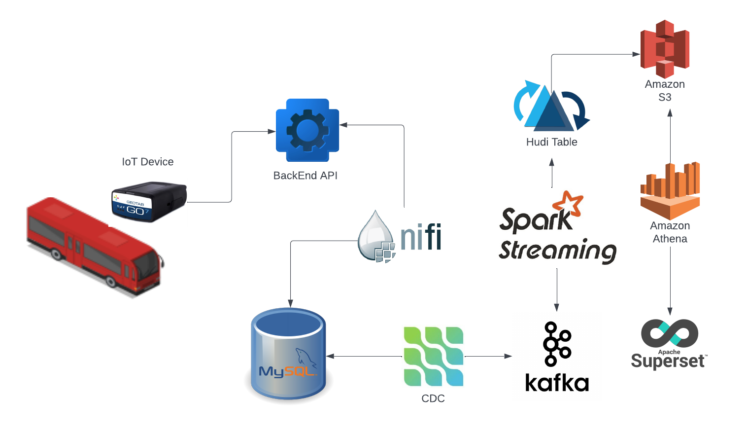
ARCHITECTURE

Slide 3
Objective and Purpose
Stream bus data from an API and uploading it into an AWS S3 Bucket for analysis
NIFI to collect and process the data from the API
Mysql (debezium) to store the data
Kafka to stream the data into Pyspark to be manipulated
Pyspark will manipulate the data into hoodie form into s3 bucket
All steps above are done in an EC2 instance (and Docker container)
AWS Athena is used to read the data and Superset (or PowerBi) to analyze the data

Slide 4
Things I have learned
Value of Kafka of being able to process data instantly
Working with different, unfamiliar datasets (mapping data)
A lot of new technologies (More technical NIFI, Kafka, EC2 and docker installations)
Having the skills to utilize the data properly. I never worked with mapping data before, analytics was challenging for me. It showed me how data engineers and data analyst/scientist have different skills.
Kafka connector kept breaking, new connection every bootup. Could have been fixed by bash scripting.

Slide 5
If I had more time (knowledge)
I would map the route using latitude and longitude to find the exact location of the bus.
Then using that data I can find the portion of road that is the fastest or the slowest in a 3d graph, filtered by the direction ID
Learn more about mapping and how to create better graphs for analytical purposes
Bash script the setup process (high value)

